Slide 1
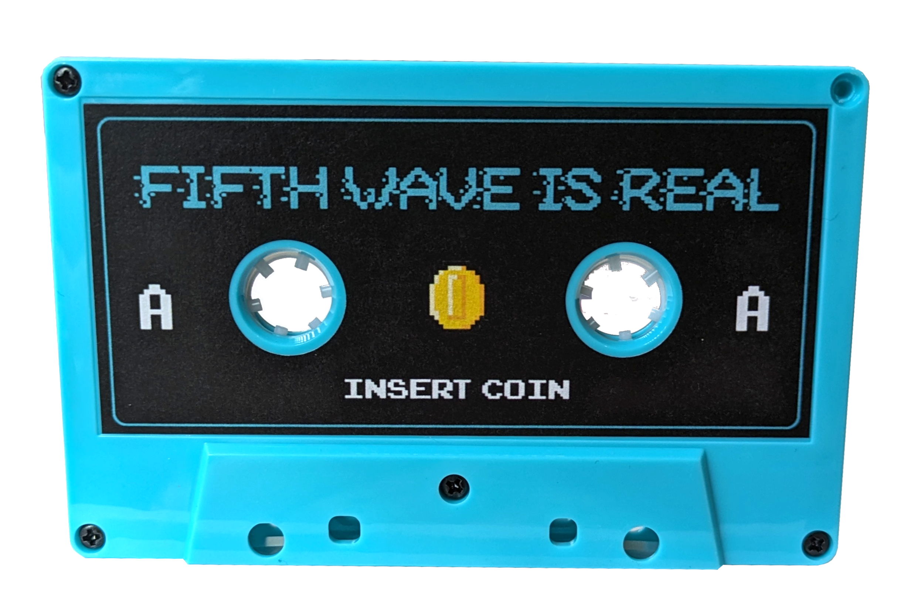
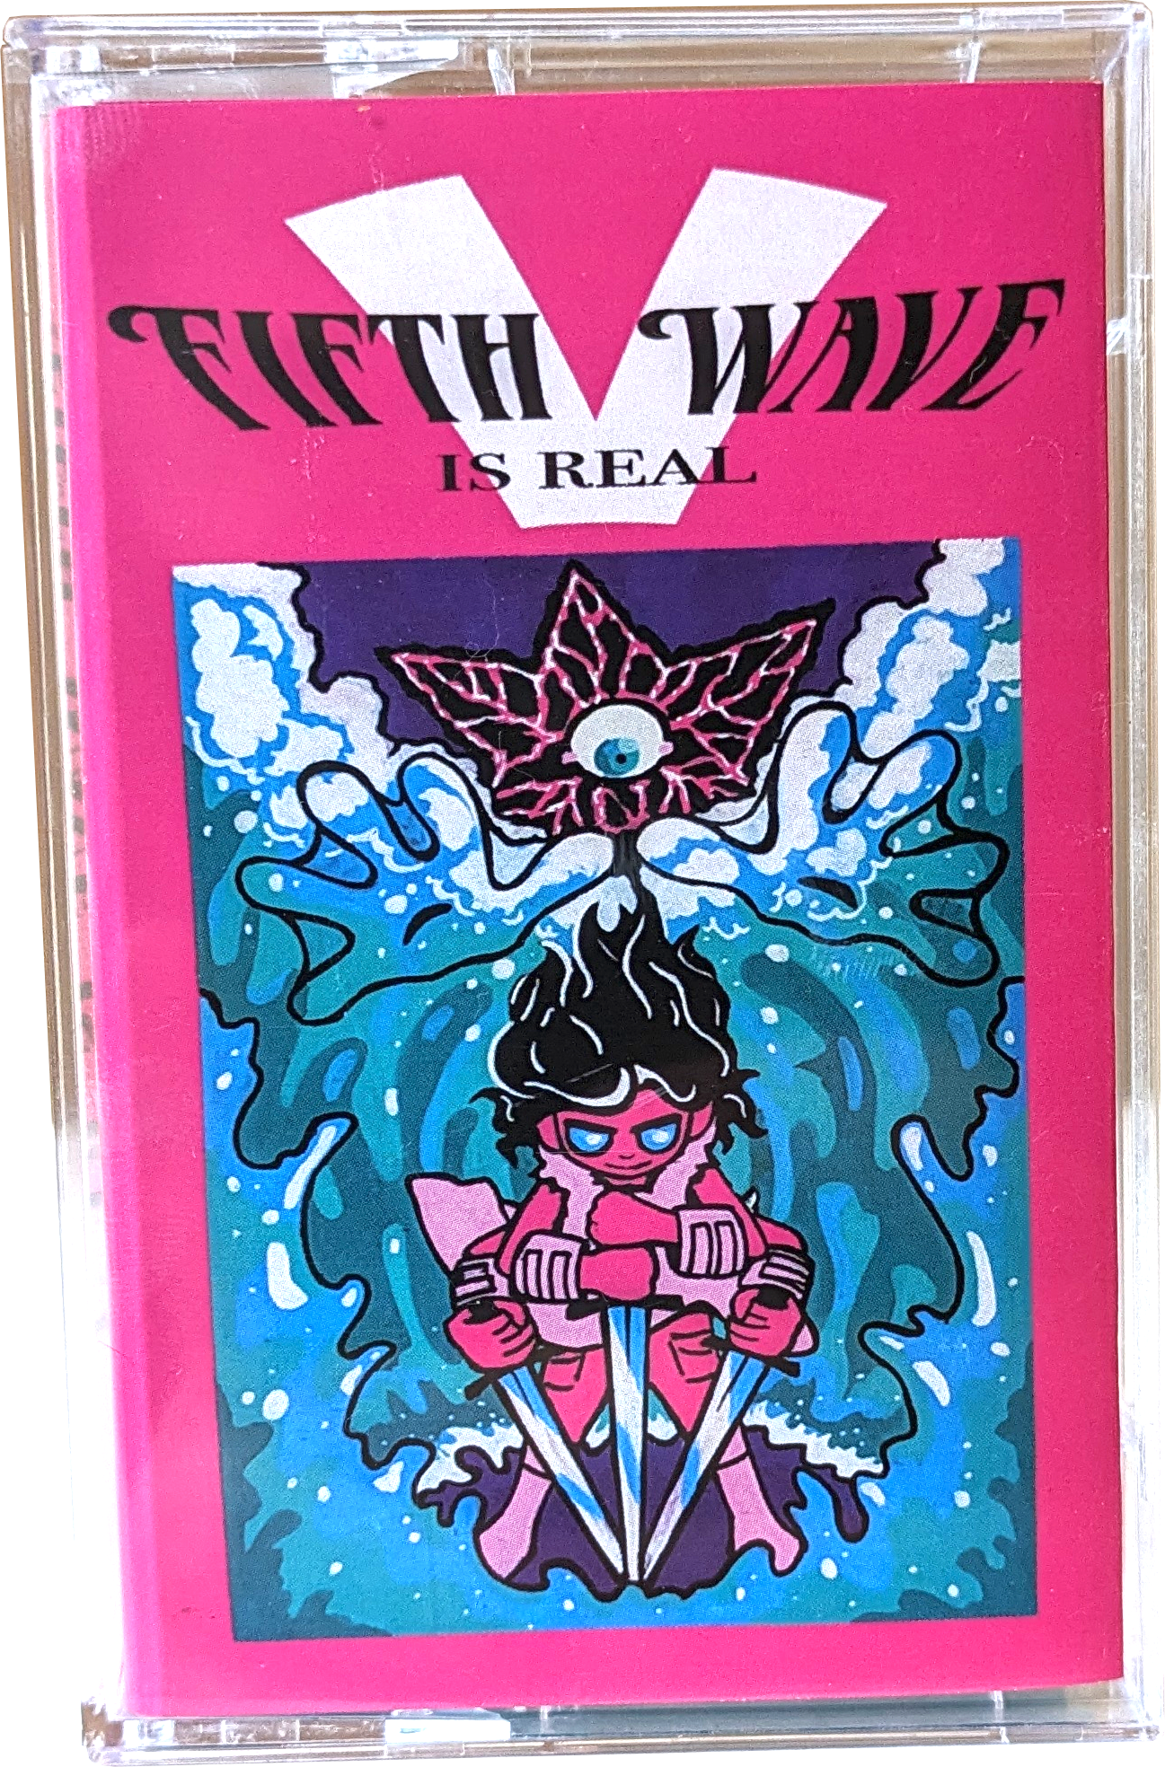


Slide 2




Slide 3

JUNE 14
9AM PT
/60
All profits
donated to
merch.chpoint.online
SHIPPING EVERYWHERE

